Slide 1
Storage Devices We use everyday
Belorukova Elizaveta
2 year student,1 group
Computer science and computer facilities

Slide 2
Запоминающие устройства которые мы используем каждый день
Белорукова Елизавета
2 курс, 1 подгруппа
Информатика и вычислительная техника

Slide 3
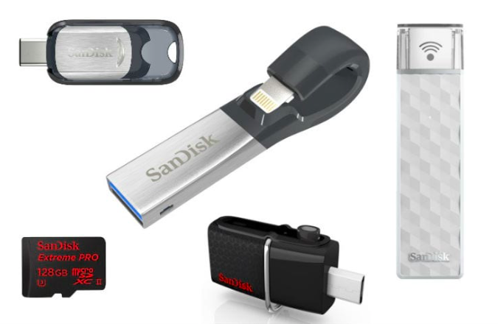
What does Storage Device mean?
A storage device is any computing hardware that is used for storing, porting and extracting data files and objects.

Slide 4
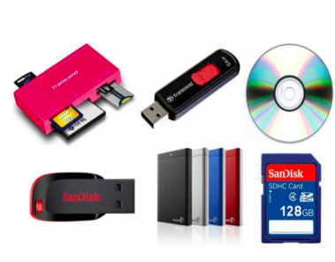
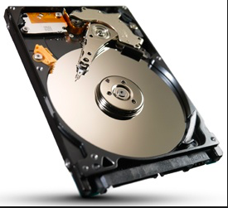
The device can be external or internal to a computer, server, and other computing systems.
External Internal

Slide 5
Types of storage device
There are two types of storage device: secondary storage device and primary storage device.

Slide 6
Secondary storage devices
A secondary storage device has a larger storage capacity and can store data permanently.

Slide 7
Primary storage device
A primary storage device is quite smaller in size and it’s designed to capture or hold data for a temporary period.

Slide 8
Examples of storage devices
Hard disk.
DVDs.
CDs.
Magnetic tape.
Flash memory (USB memory sticks)

Slide 9
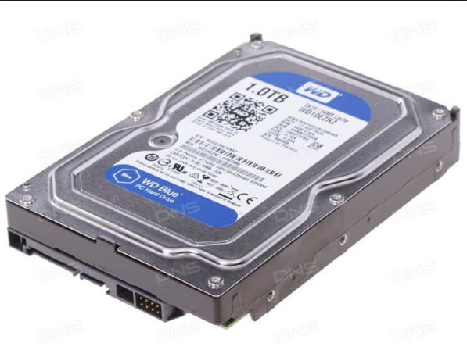
Hard disk

Slide 10
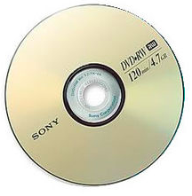
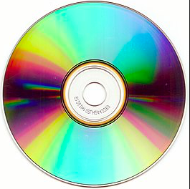
DVDs and CDs

Slide 11
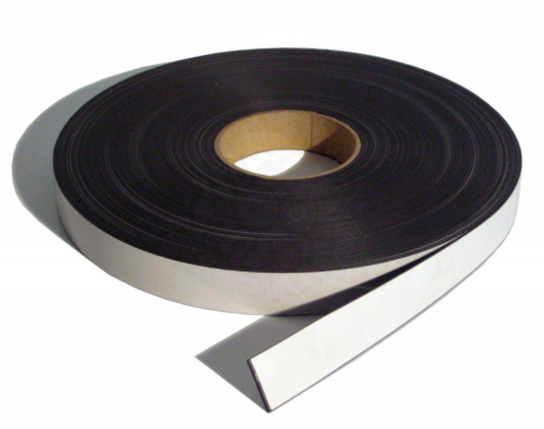
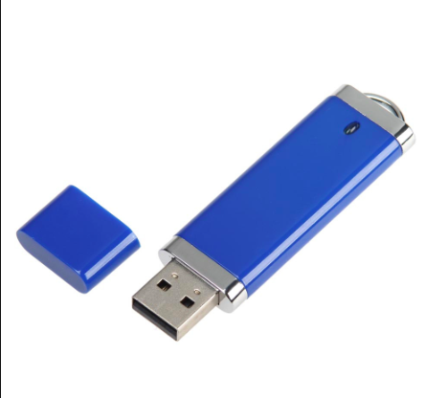
Magnetic tape and Flash memory

Slide 12
Common Problems encountered with Storage devices
Hardware failure.
Data Loss.

Slide 13
Nowadays, storage devices are of great importance in people's lives, so SD are improved and become more reliable.

Slide 14
Thank you for your attention
Спасибо за внимание

